Slide 1
Evaluating a Large Language Models for MDS-UPDRS Finger Tapping Severity Assessment
Gary Wang
Torbjörn E. M. Nordling, Ph.D.
Nordling Lab
Dept. of Mechanical Engineering
National Cheng Kung University
No. 1 University rd., Tainan 70101, Taiwan

Slide 2
Outline
Background
Introduction
Methods
Results
Conclusion
Discussion
Future work

Slide 3
Background

Slide 4
Background
Parkinson’s Disease (PD)
Neurological disorder affecting 11.8 million globally in 2021.
Characterized by bradykinesia (slow decremental movement).
MDS-UPDRS Item 3.4: Finger Tapping (FT)
A rating scale (0, 1, 2, 3, 4) for diagnosing bradykinesia.
Assesses interruptions, slowing, and amplitude decrement.
Instruction: Tap index finger on thumb 10 times as fast as possible.
Problem Statement
Current diagnostic method dependent on movement disorder specialists.
Time consuming, costly, manual rating introduces variability and subjectivity.
Study Goal
Evaluate FT scoring by LLMs, with an analysis process based on task description and MDS-UPDRS FT instructions and compare its performance to that of clinical neurologists.

Slide 5
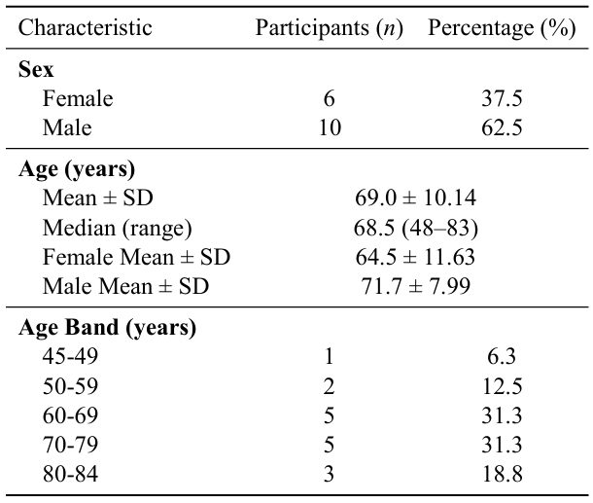
Demographic Characteristics of Participants

Slide 6
Introduction

Slide 7
What are Tokens?
The fundamental unit of text processing for LLMs.
1000 tokens ≈750 English words.
Critical Factor: Raw numerical data (coordinates) consumes massive amounts of tokens.
Why Token Count Matters:
Cost: API usage is billed per token.
Focus: Too much irrelevant data distracts the model.

Slide 8
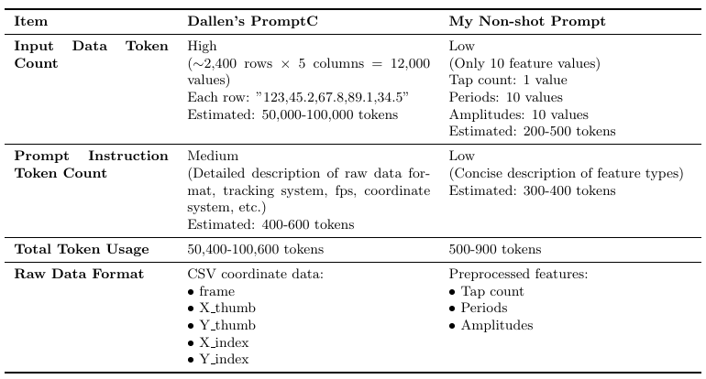
Comparison of non-shot prompt

Slide 9
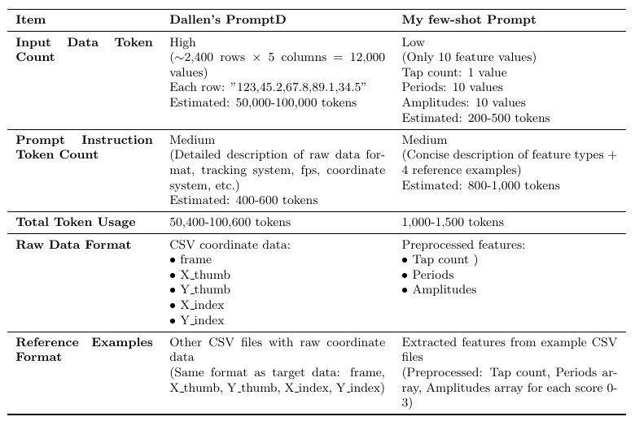
Comparison of few-shot prompt

Slide 10
Method

Slide 11
Data Processing Pipeline
Raw csv data
Feature extraction
Prompt with target data
Prompt without target data

Slide 12
Non-shot prompting
The provided CSV file contains data with five columns: frame, X_thumb, Y_thumb, X_index, and Y_index. The first column repre sents the frame number. The second and third columns represent the x and y coordinates of the thumb sticker, respectively. The fourth and fifth columns represent the x and y coordinates of the index finger sticker, re spectively. This data comes from a subject performing the MDS-UPDRS finger tapping test, with stickers fixed to the thumb and index finger. The subject was instructed to tap the index finger on the thumb 10 times to perform continuous finger tapping. Cameras recording at a frame rate of 240 frames per second (fps) captured the movement.
The data provided below consists of extracted features (tap count, periods, and amplitudes) derived from a subject performing the MDS-UPDRS Item 3.4 Finger Tapping test. The subject was instructed to tap the index finger on the thumb 10 times as quickly and as largely as possible.

Slide 13
Non-shot prompting
To determine the subject’s score, analyze the provided data thor oughly and give a detailed motivation for the assigned score based on the MDS-UPDRSfinger tapping instruction. Print the score using only one number on the last line of your answer, after the detailed motivation.
Below are the extracted features including tap count, periods, and amplitudes. Please analyze this information and provide your score on the last line.

Slide 14
Few-shot prompting
The provided CSV file contain target data with five columns: frame, X_thumb, Y_thumb, X_index, and Y_index. The first column repre sents the frame number. The second and third columns represent the x and y coordinates of the thumb sticker, respectively. The fourth and fifth columns represent the x and y coordinates of the index finger sticker, respectively. This targetdatacomesfromasubjectperformingtheMDS-UPDRSfinger tapping test, with stickers fixed to the thumb and index finger. The subject was instructed to tap the index finger on the thumb 10 times to perform continuousfingertapping. Camerasrecordingataframerateof240frames per second (fps) captured the movement.
You are an expert neurologist specializing in Parkinson's Disease. Your task is to score the severity of a Finger Tapping (FT) test according to the MDS-UPDRS Item 3.4 criteria.

Slide 15
Few-shot prompting
### 2. FEW-SHOT REFERENCE EXAMPLES Use the following examples (features extracted from patients with known scores) to calibrate your analysis. -- Score 0 -- Taps: 11 Periods: [108, 112, 117, 115, 123, 122, 118, 105, 102, 119] Amps: [183, 189, 187, 196, 180, 176, 185, 175, 180, 176, 182] -- Score 1 -- Taps: 11 Periods: [70, 69, 75, 68, 66, 75, 70, 75, 81, 83] Amps: [207, 187, 171, 173, 170, 165, 177, 183, 168, 177, 175] -- Score 2 -- Taps: 12 Periods: [96, 106, 87, 104, 51, 73, 152, 72, 104, 141, 104] Amps: [188, 180, 194, 180, 177, 185, 156, 157, 146, 133, 147, 136] -- Score 3 -- Taps: 11 Periods: [219, 153, 156, 122, 119, 143, 130, 110, 120, 126] Amps: [121, 128, 125, 108, 94, 89, 100, 90, 92, 91, 111]
The provided TXT file contains features from four reference data, each representing a different score level (0 to 3) for MDS-UPDRS item 3.4: FINGER TAPPING. These reference data, scored by medical profession als as accurate representations. They are crucial for identifying the char acteristics associated with each scoring level.

Slide 16
Few-shot prompting
Determine the score for the target data file based on this correlation and alignment. Provide a detailed motivation for the assigned score, and print the score using only one number on the last line of your answer, after the detailed motivation.
### 3. INSTRUCTIONS 1. Analyze the "Target Data" provided below. 2. Compare its features (periods variance, amplitude trend) against the Reference Examples above. 3. Specifically look for: - Interruptions (sudden increases in tap periods). - Slowing (gradual increase in periods). - Amplitude decrement (decreasing pixel values over time). 4. Determine the score for the target data file based on this correlation and alignment. Provide a detailed motivation for the assigned score, and print the score using only one number on the last line of your answer, after the detailed motivation.

Slide 17
Results

Slide 18
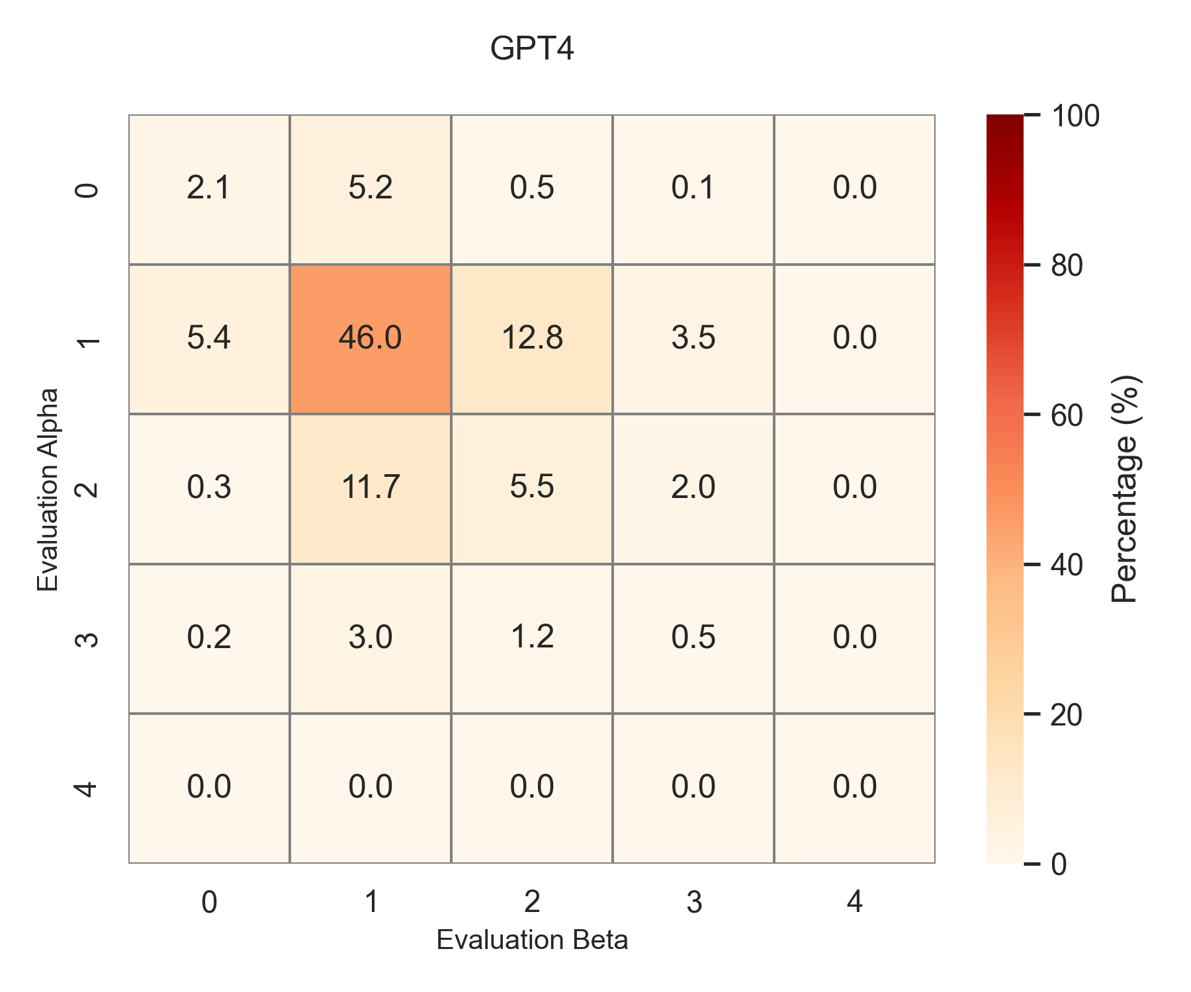
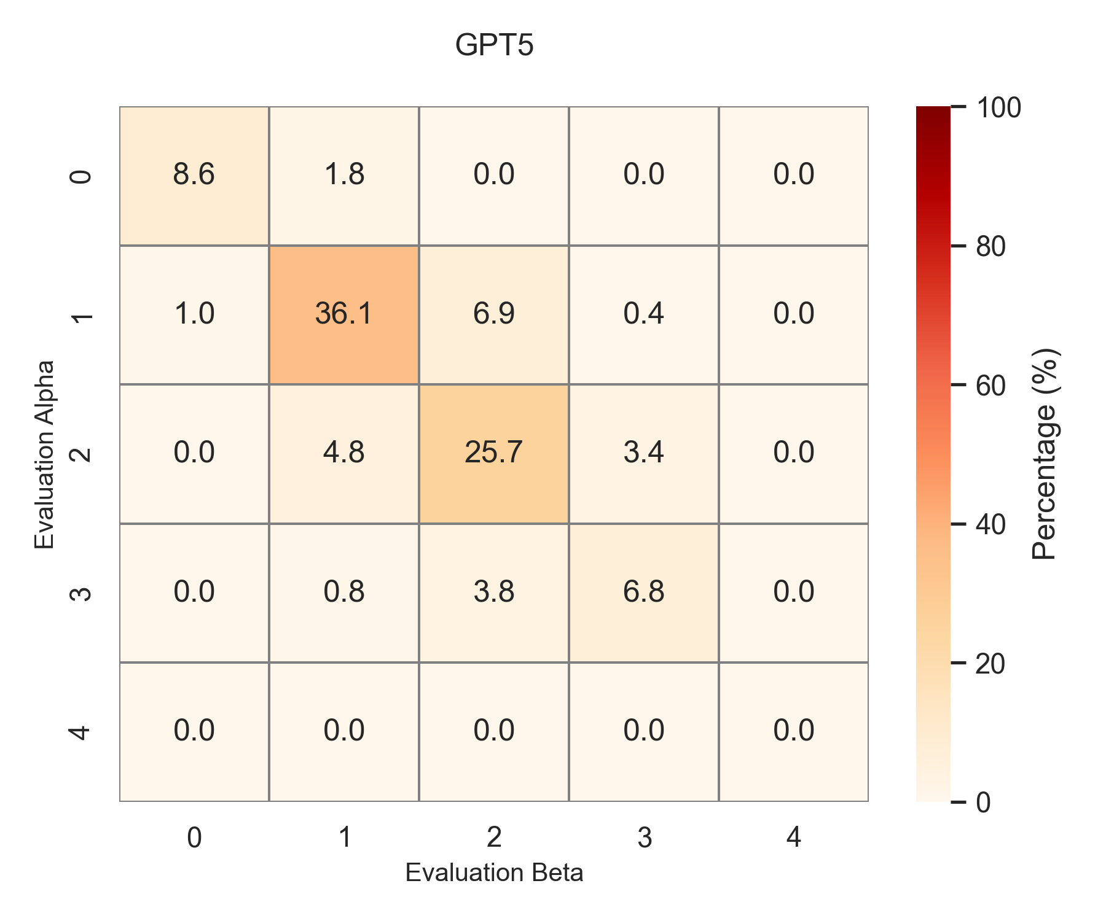
Non-shot
Here, α and β represent indices for the evaluations, where αranges from1 to 9 and β from 2 to 10, with the condition that α < β

Slide 19
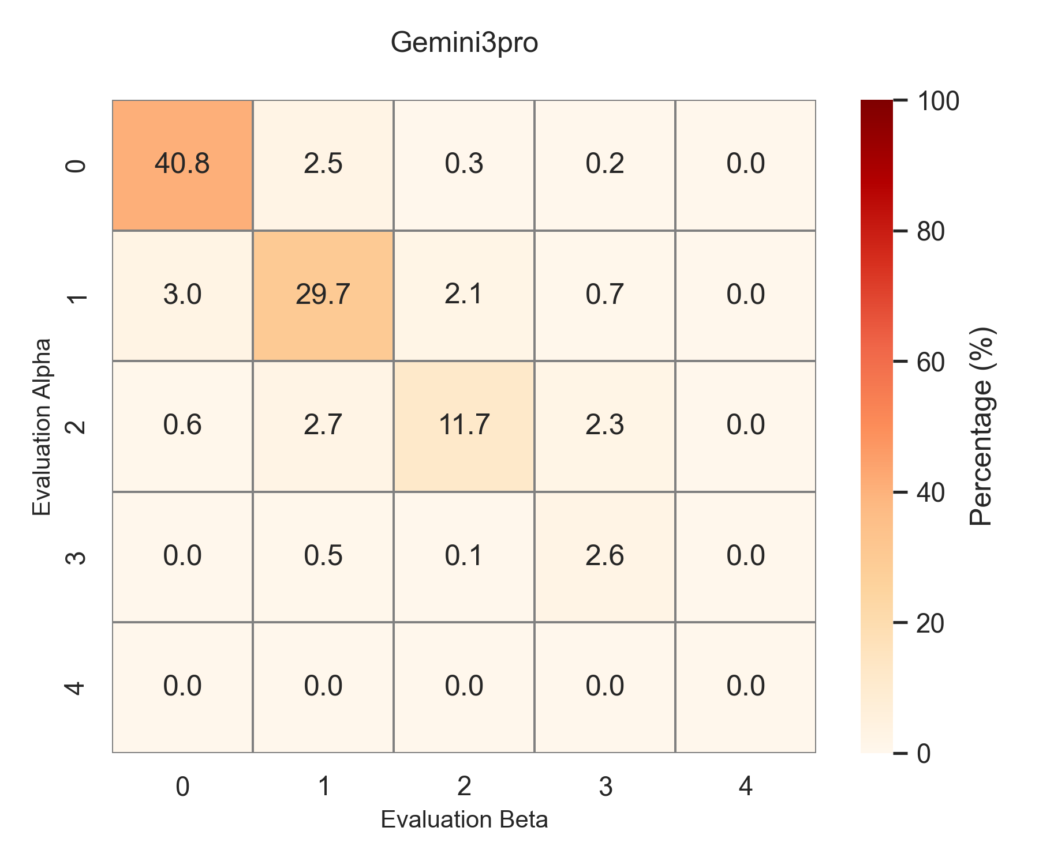
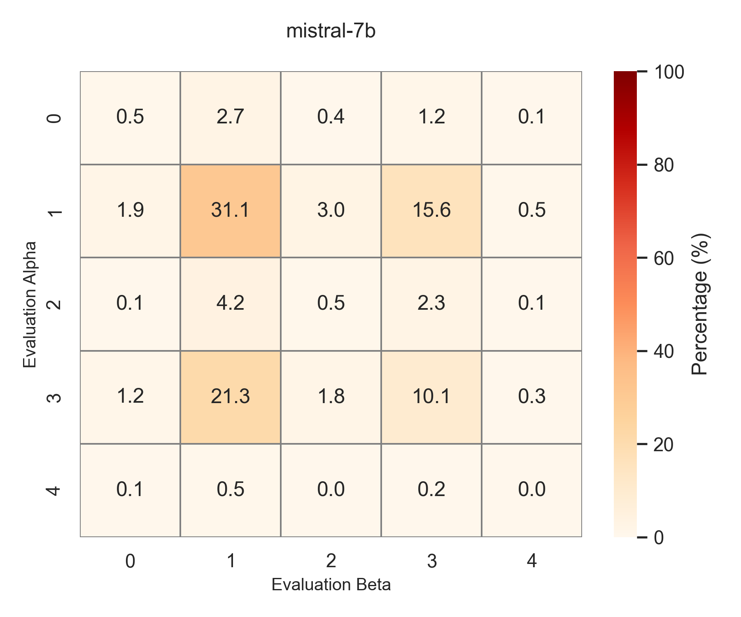
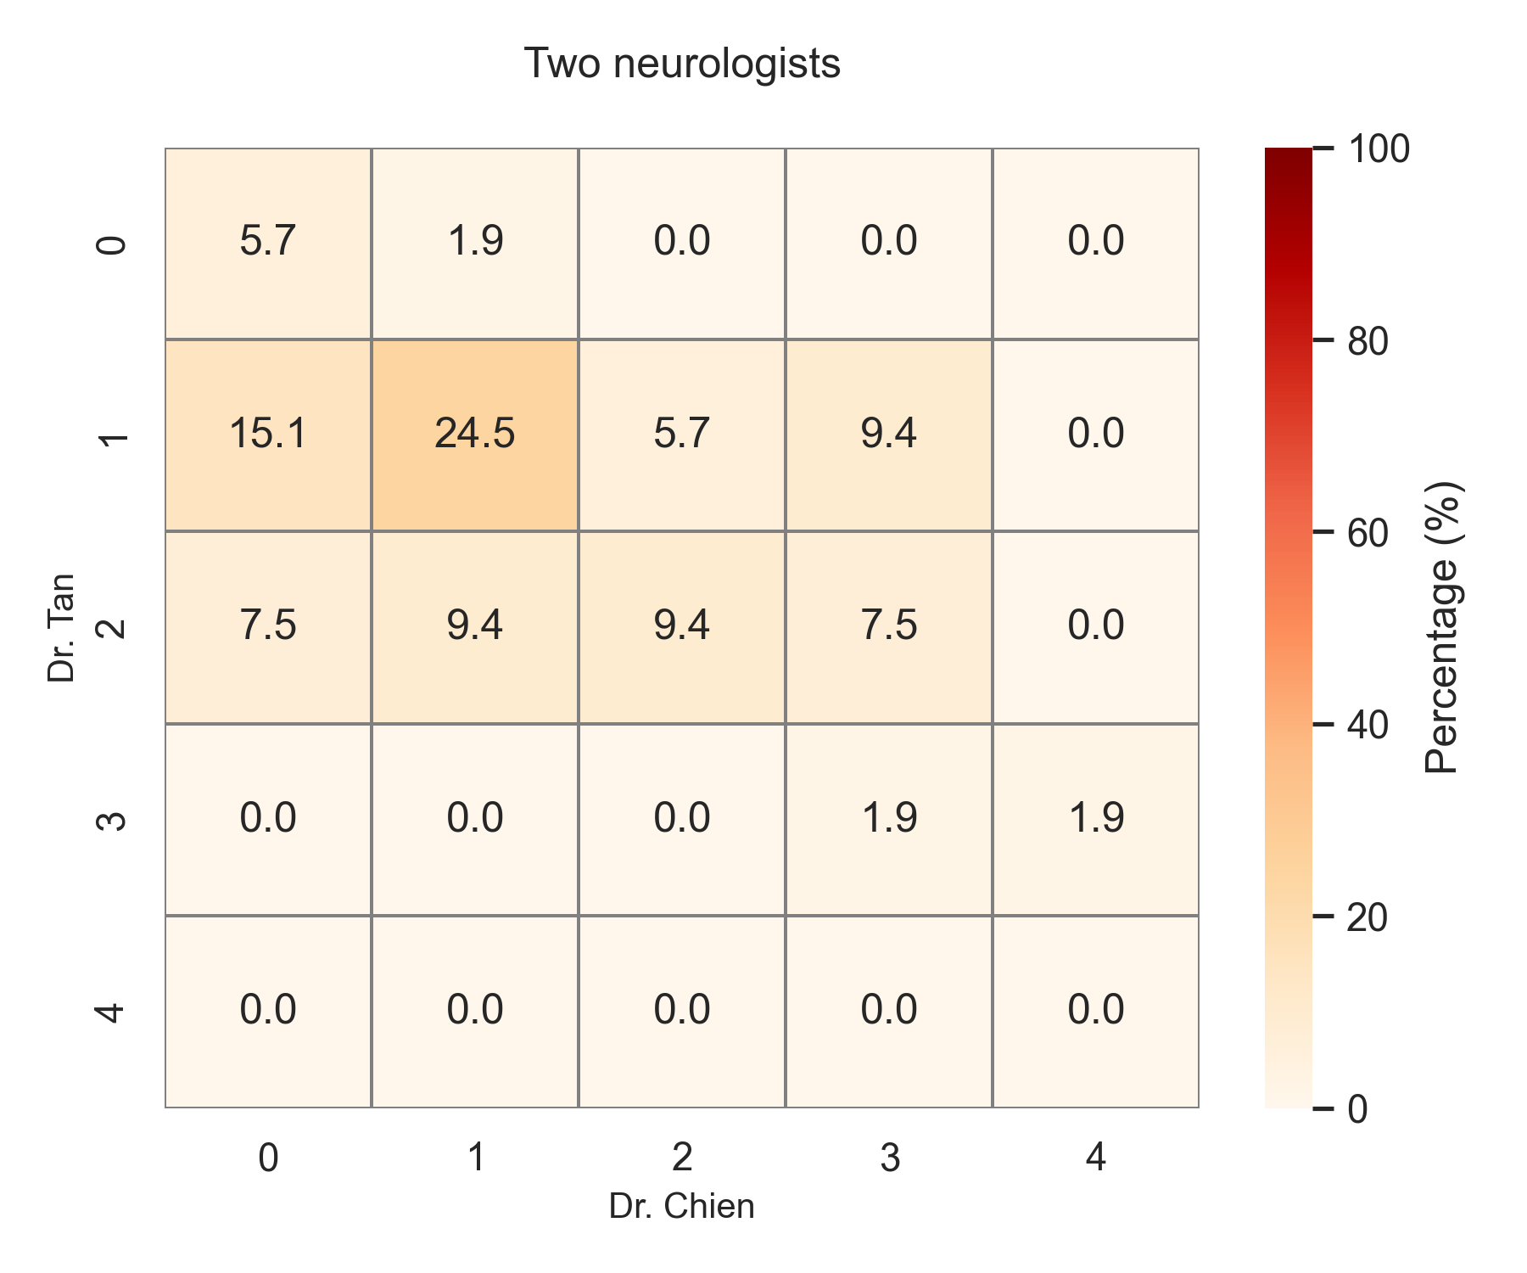
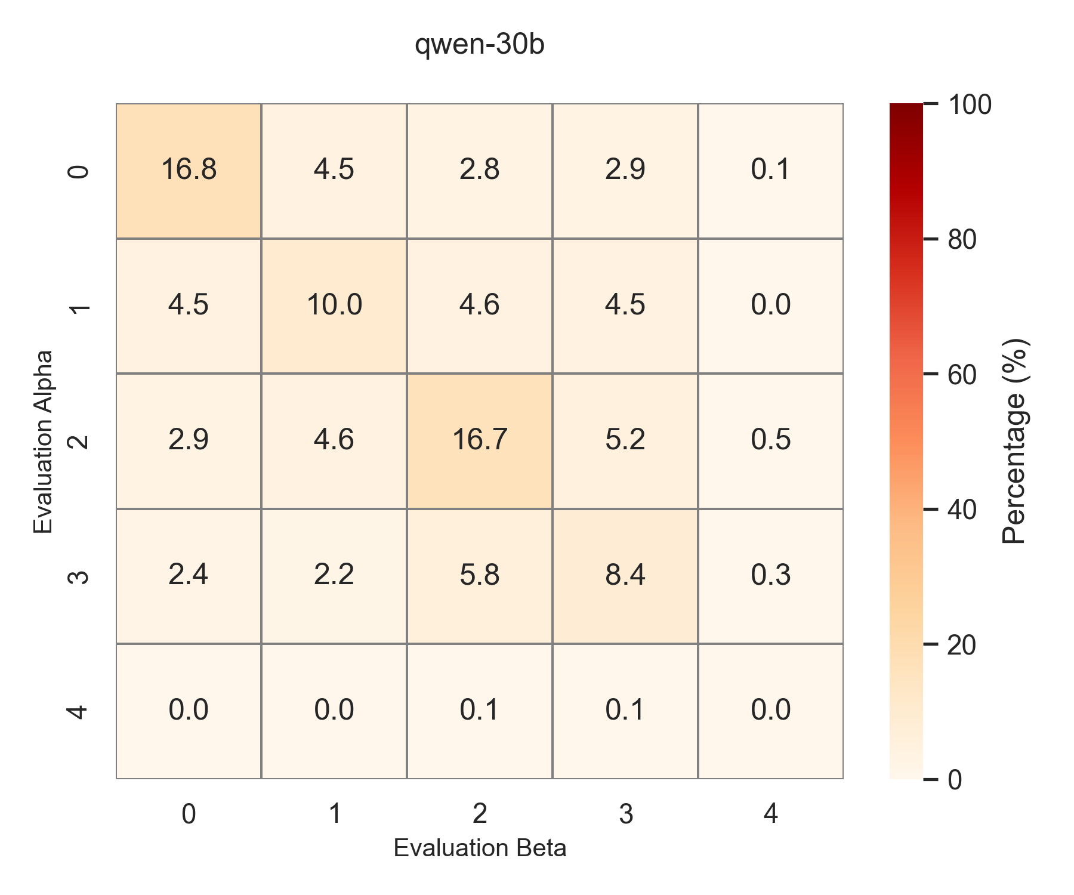
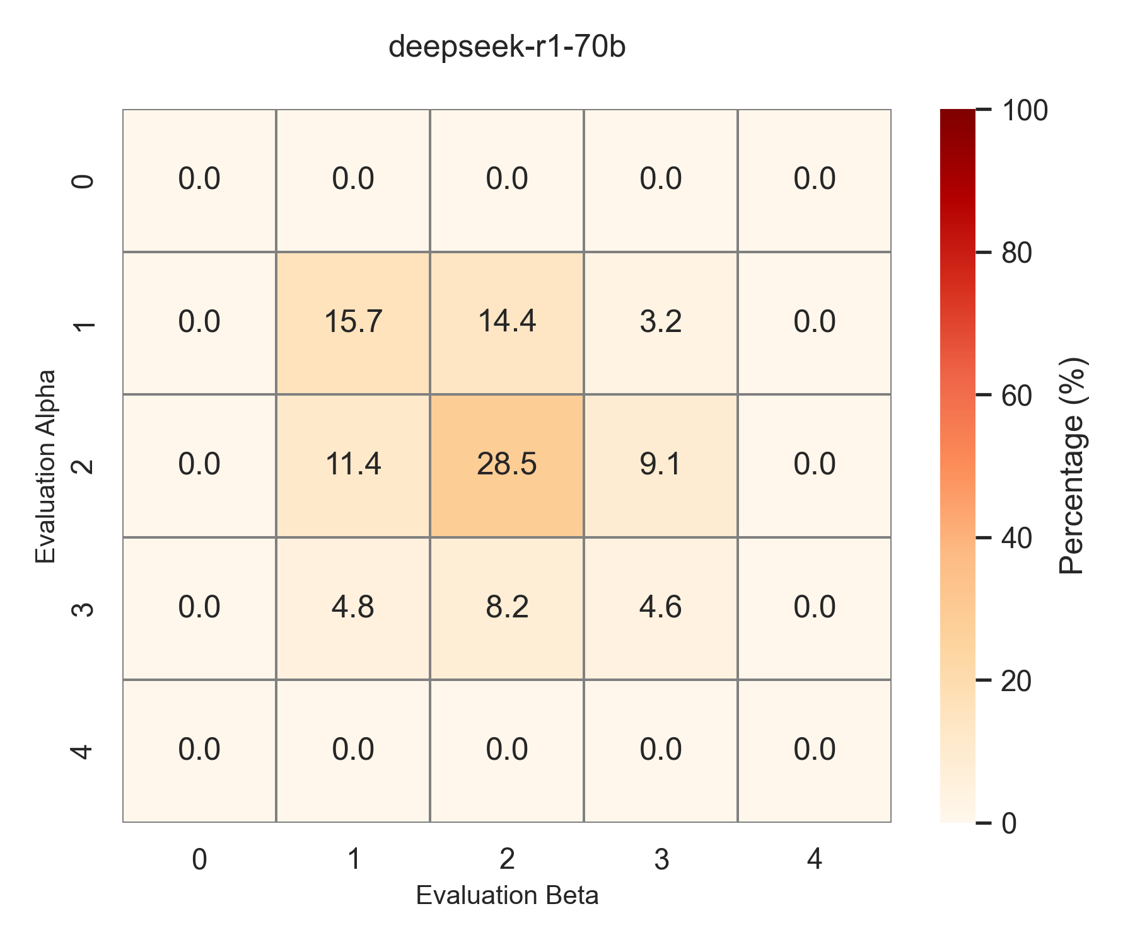

Slide 20
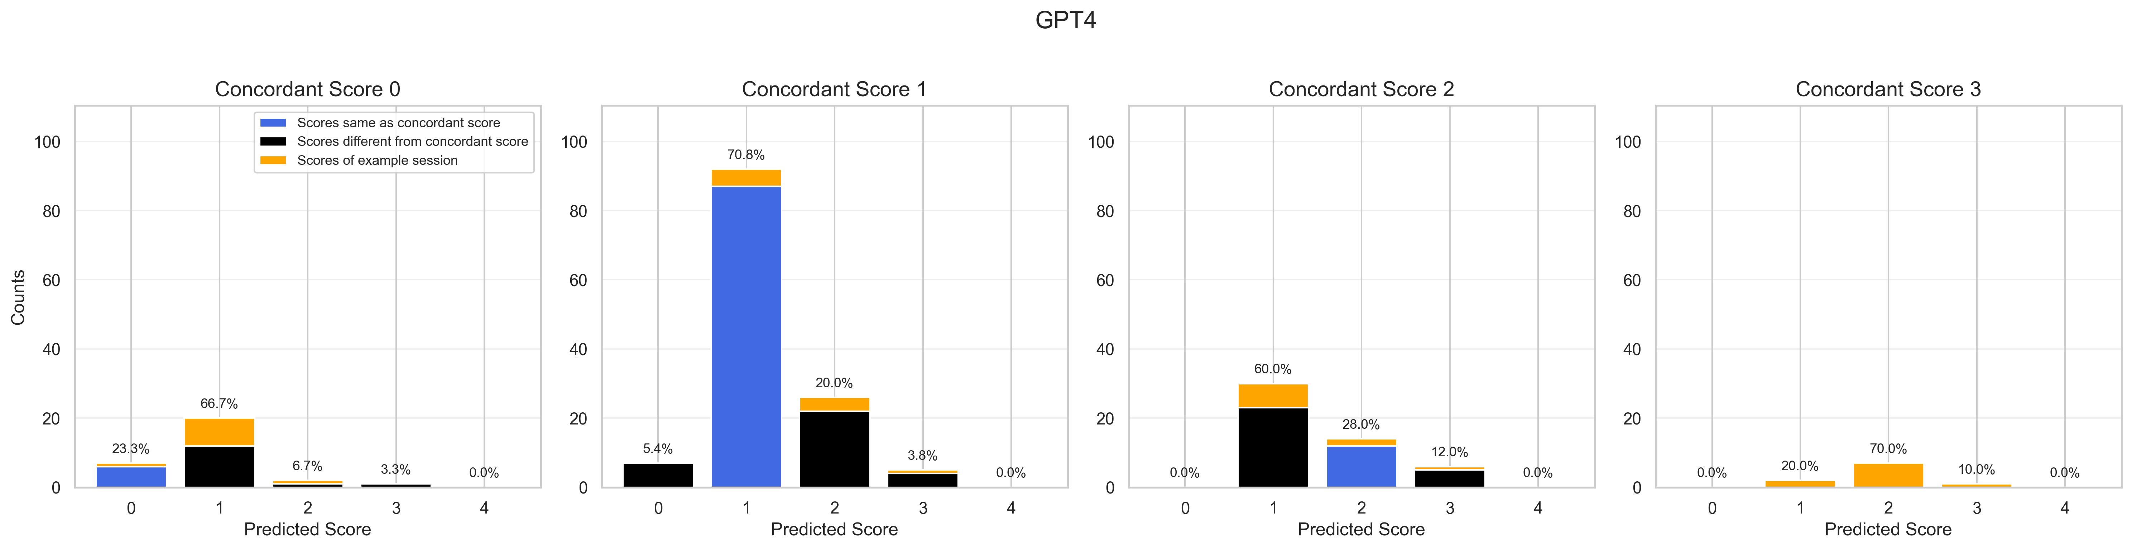
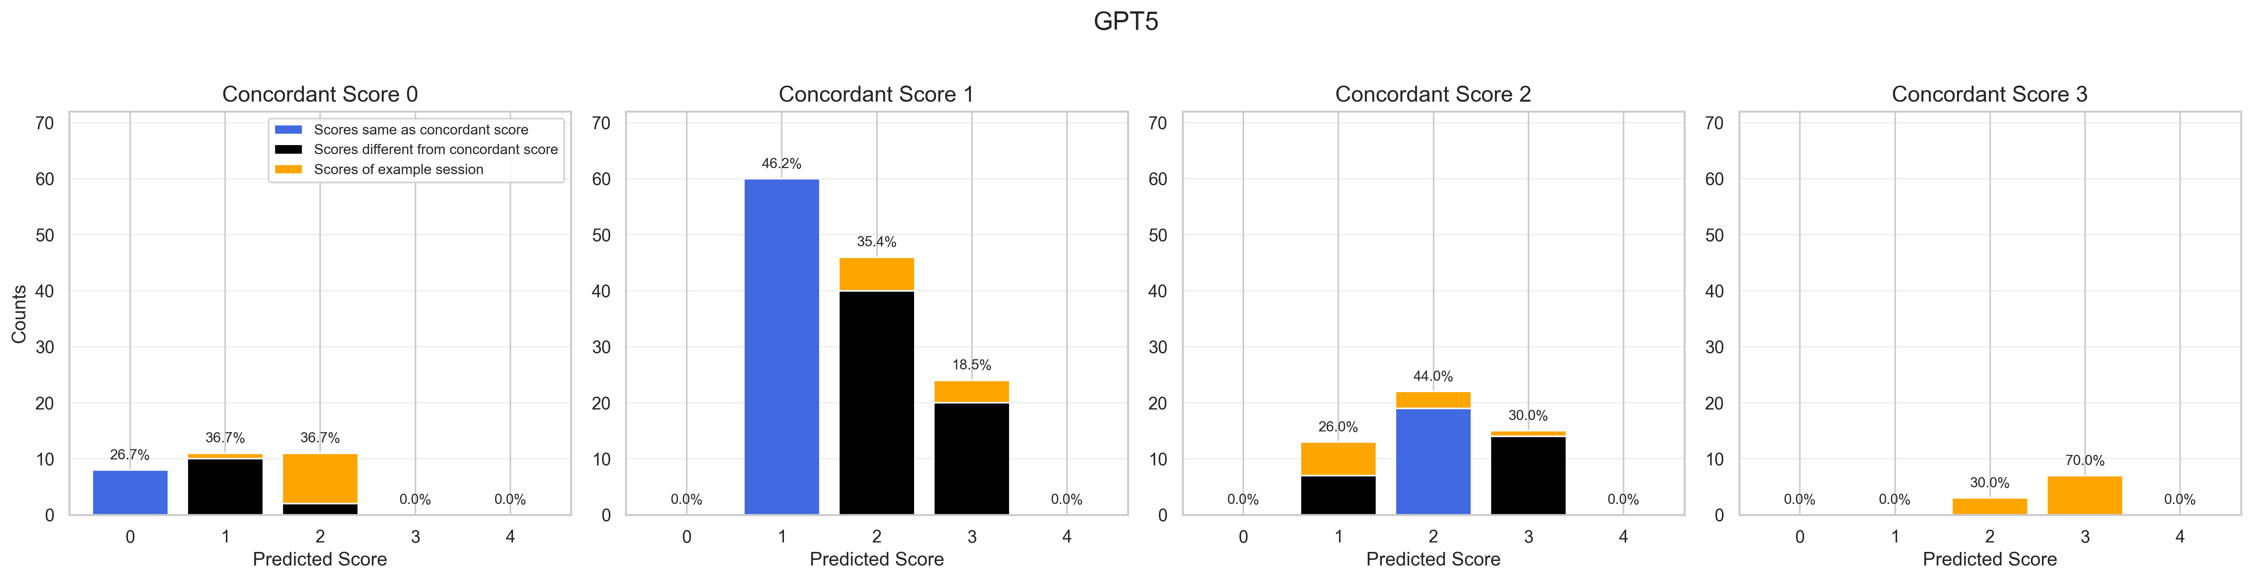
Non-shot prompting

Slide 21
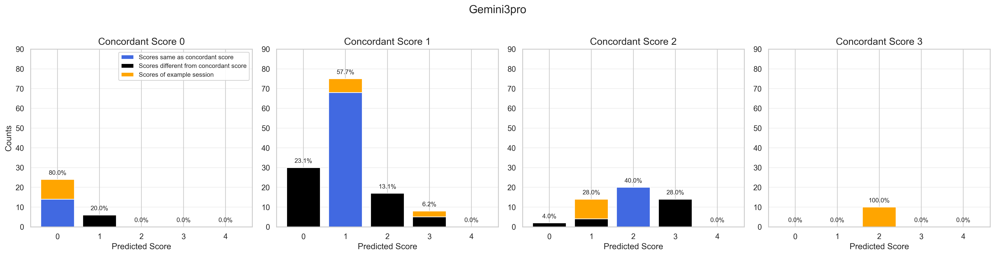
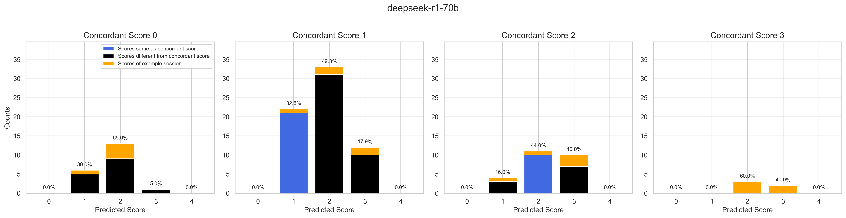

Slide 22
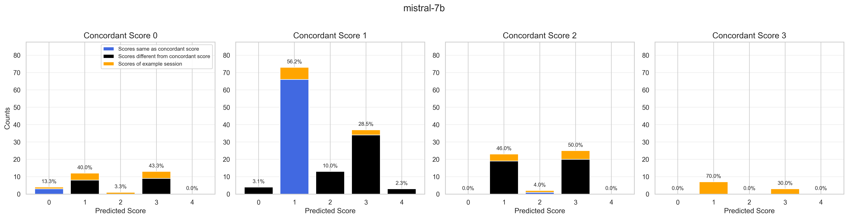
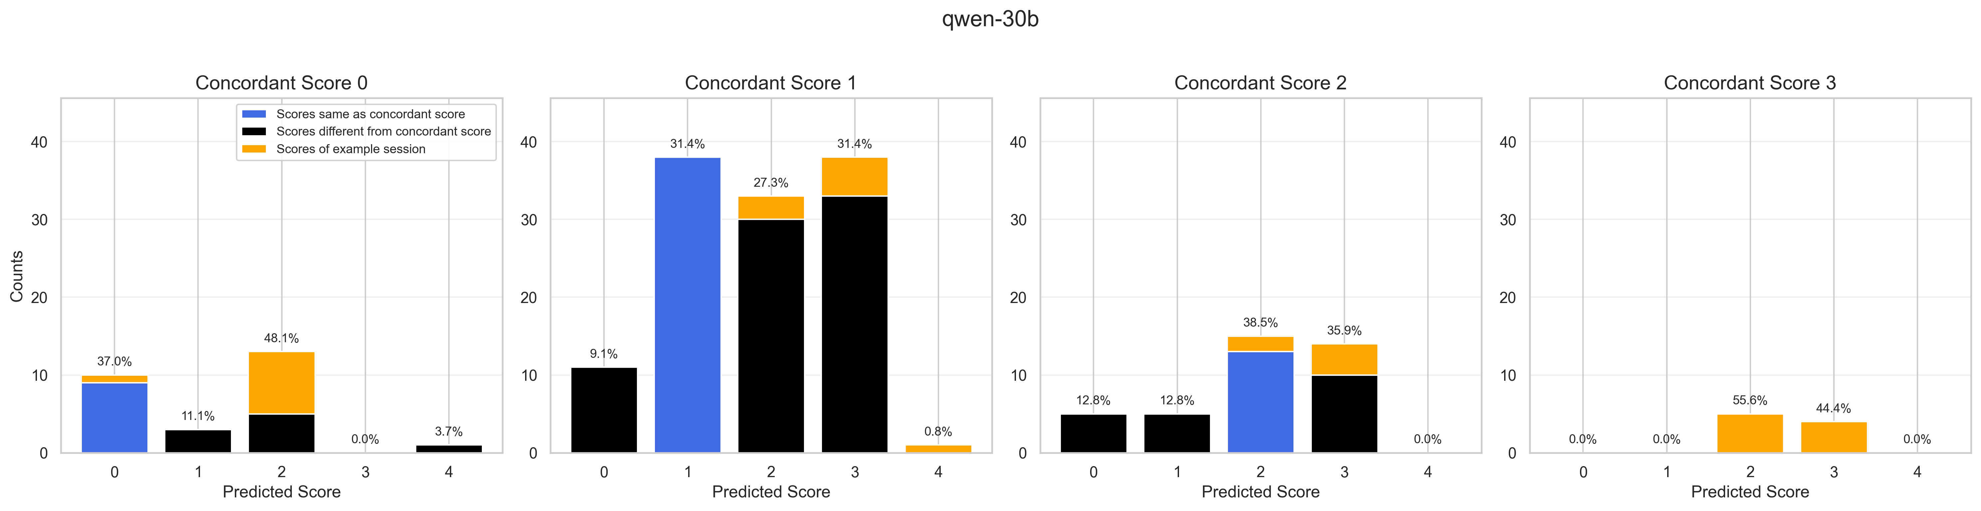

Slide 23
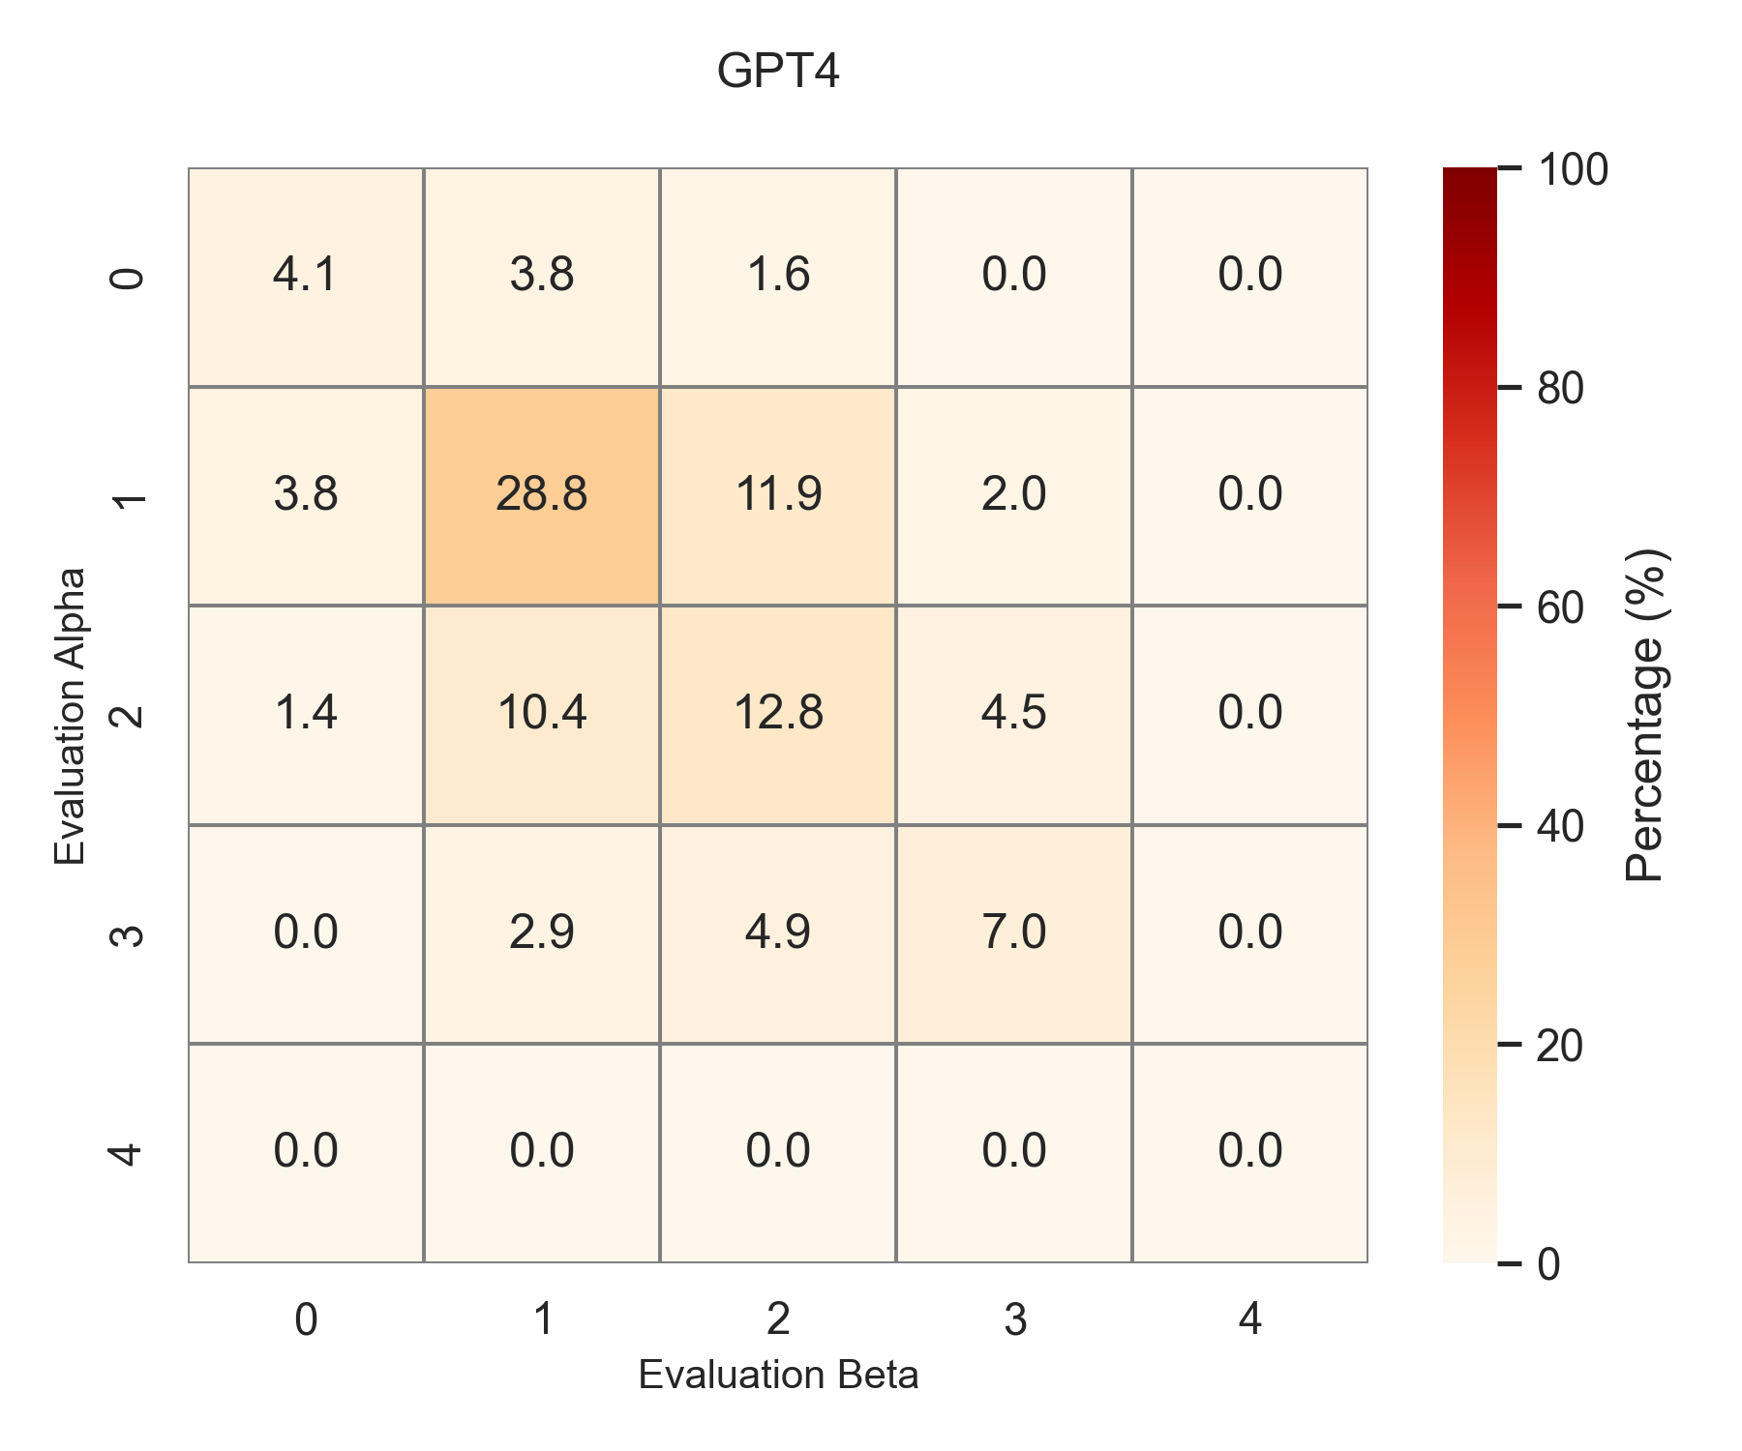
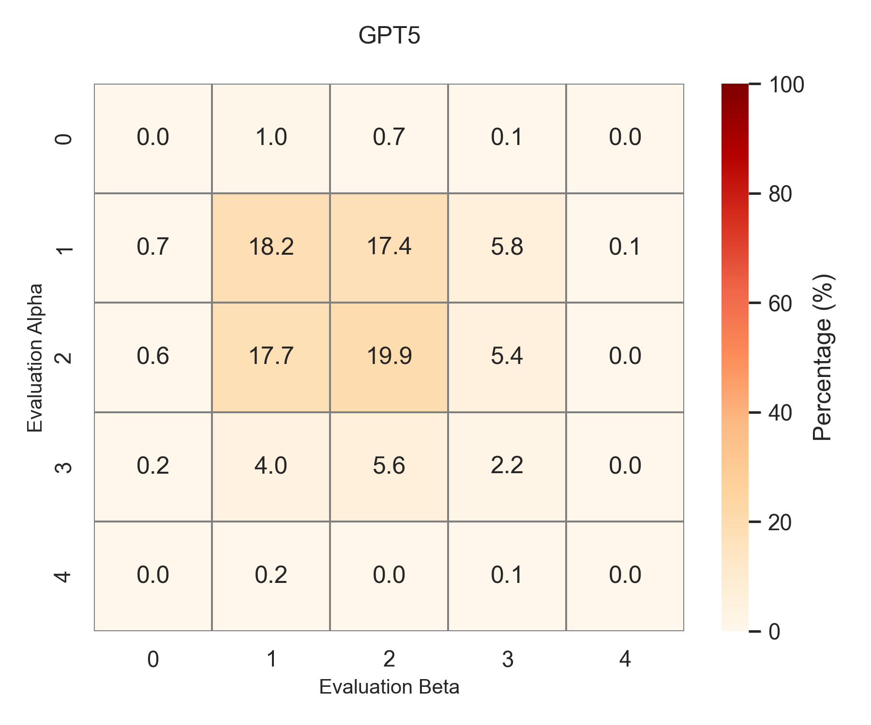
Few-shot prompting

Slide 24
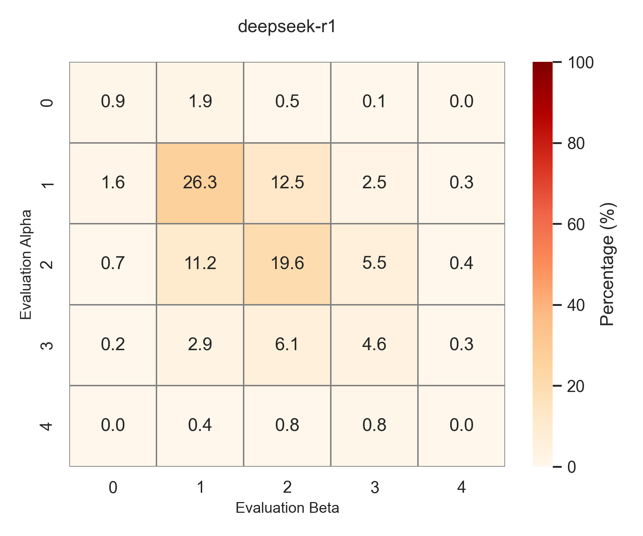
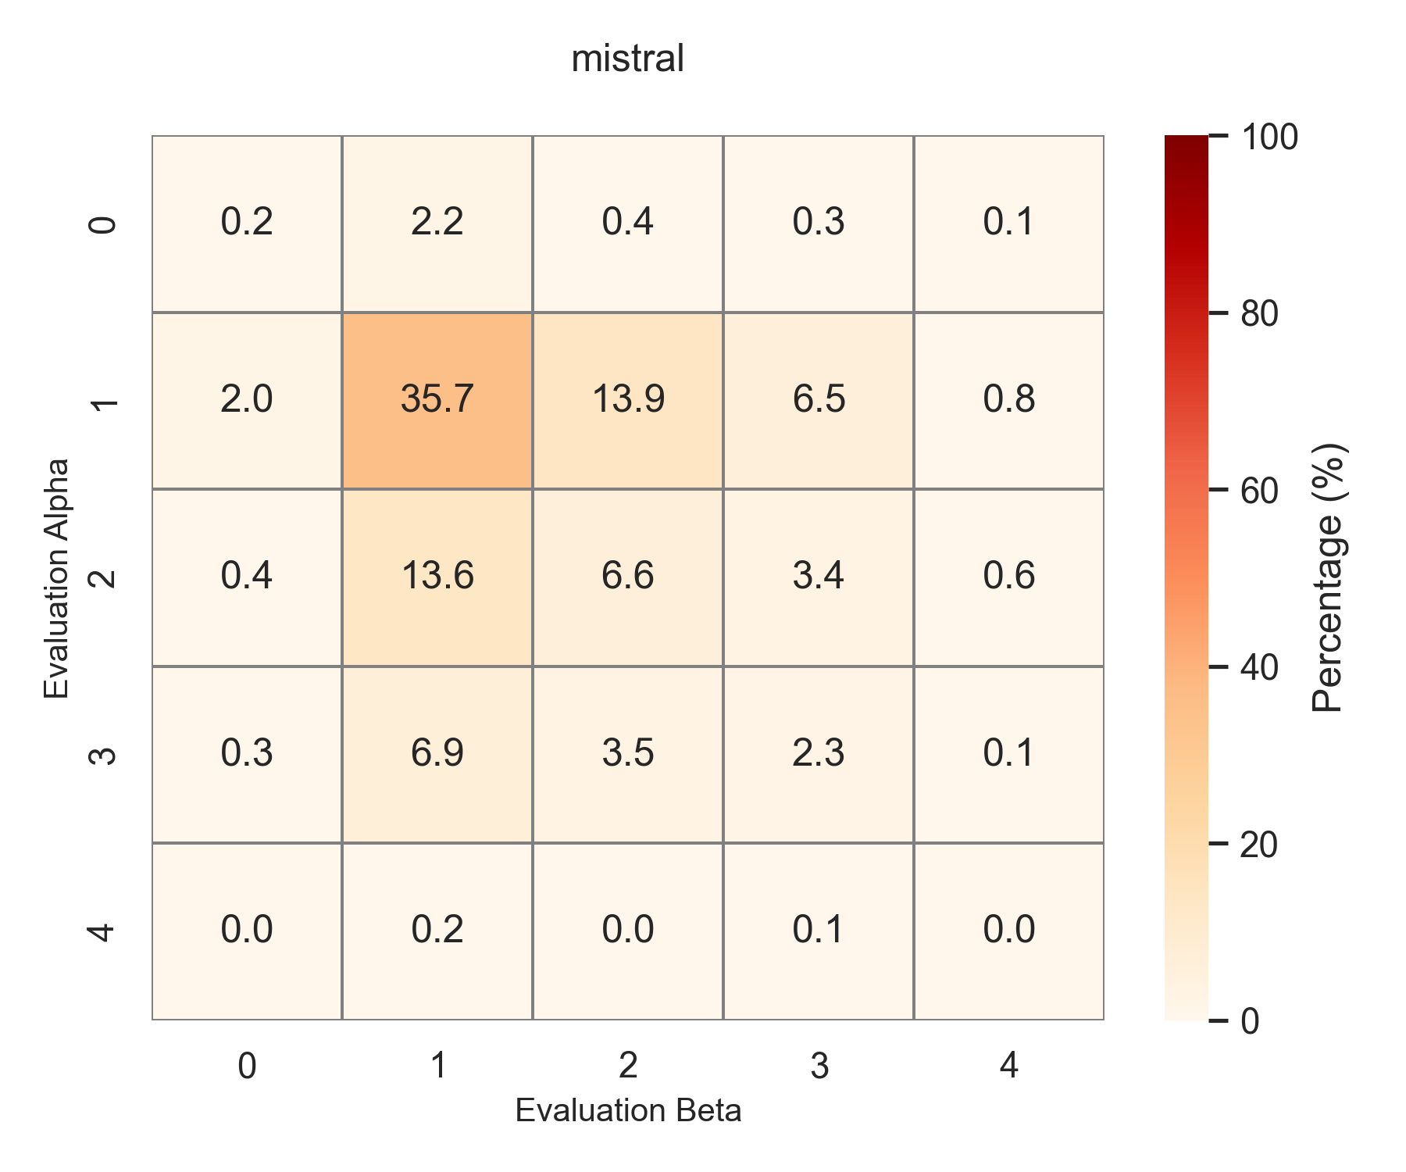
Few-shot

Slide 25
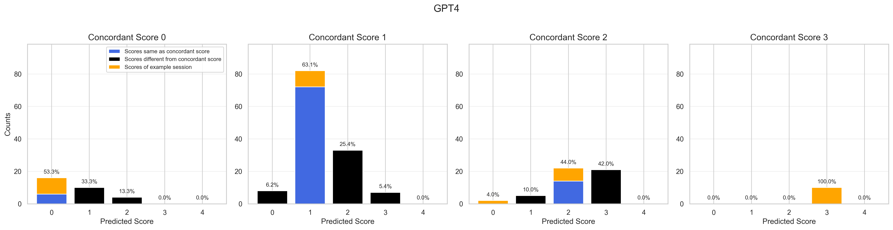
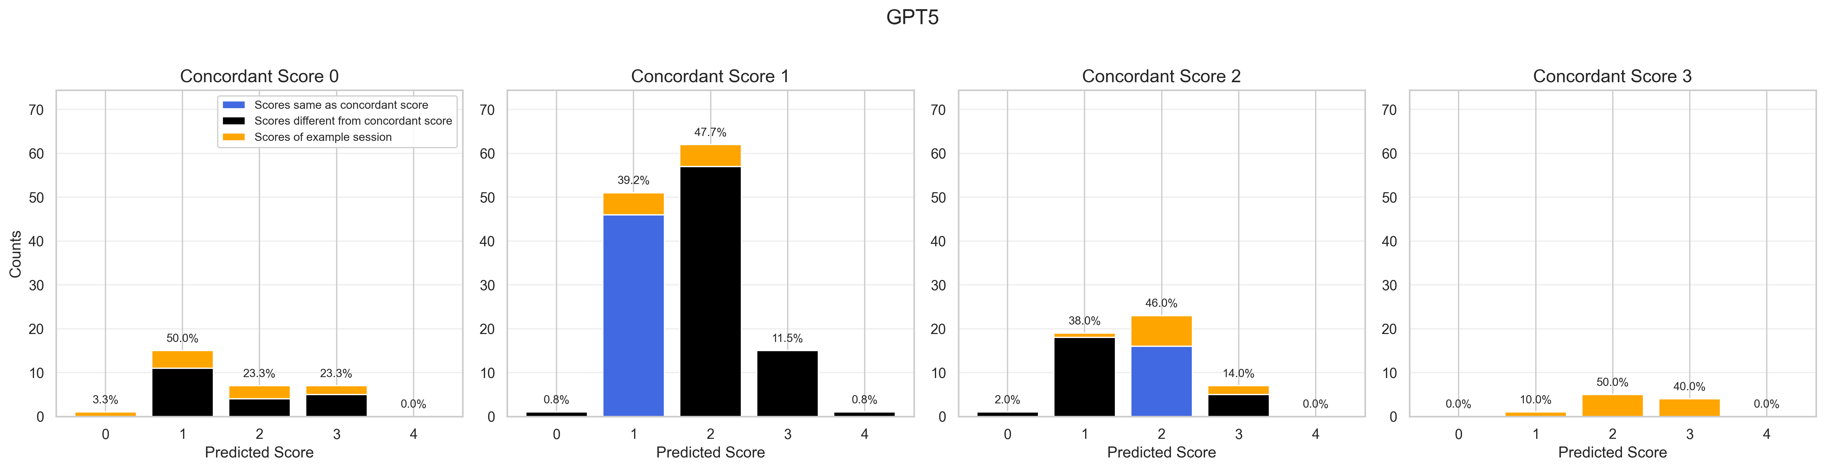
Few-shot prompting

Slide 26
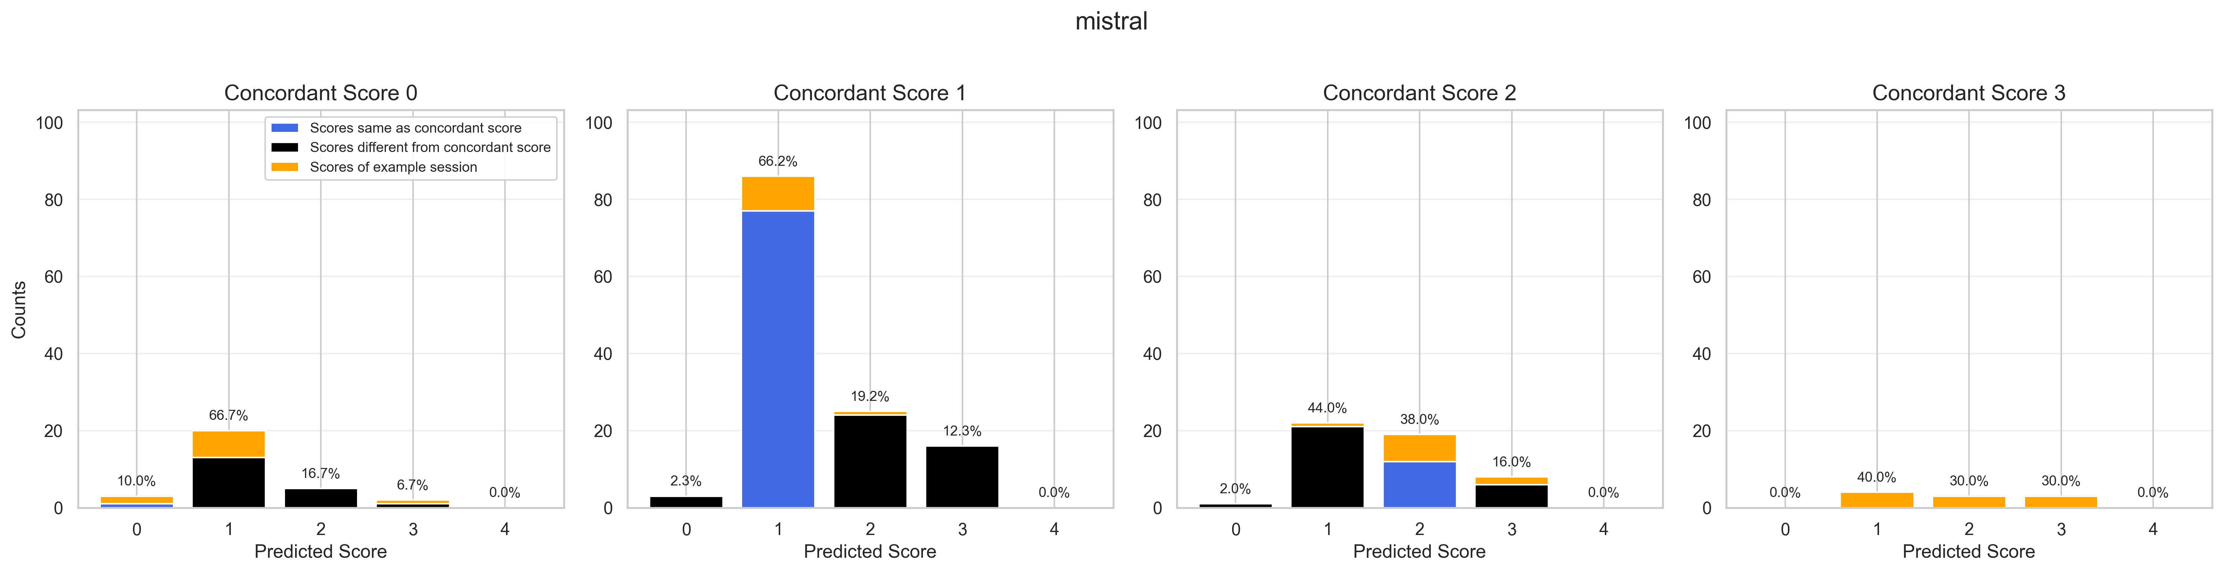
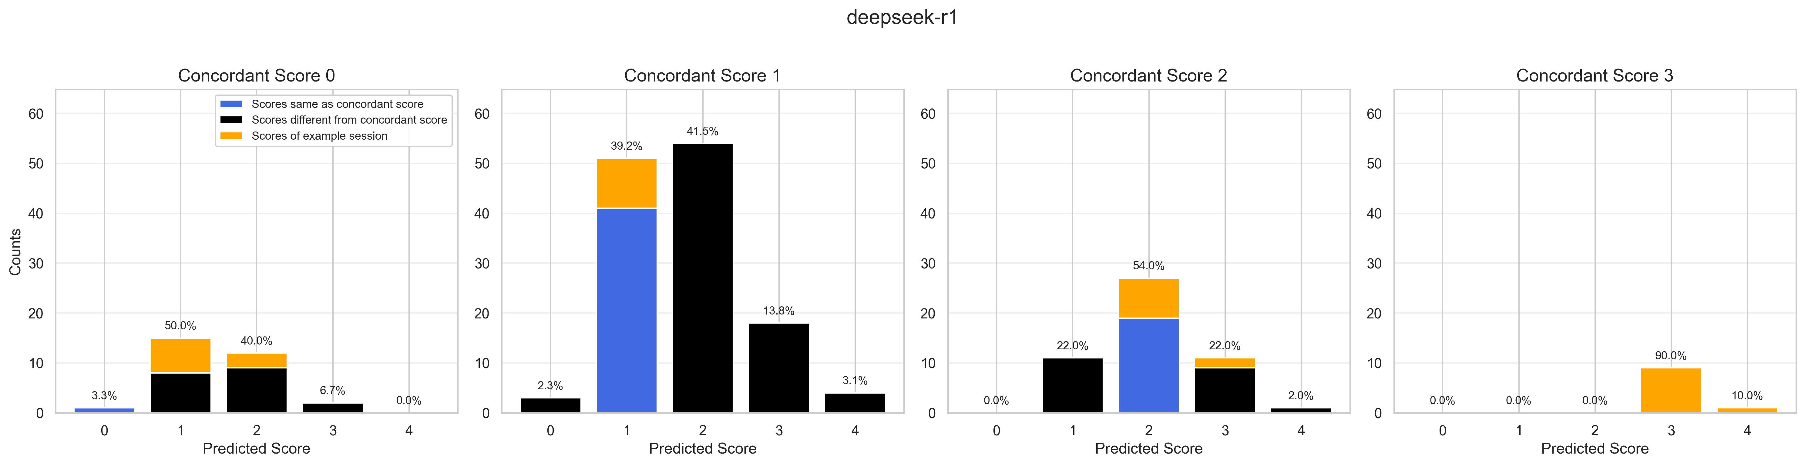

Slide 27
Conclusion

Slide 28
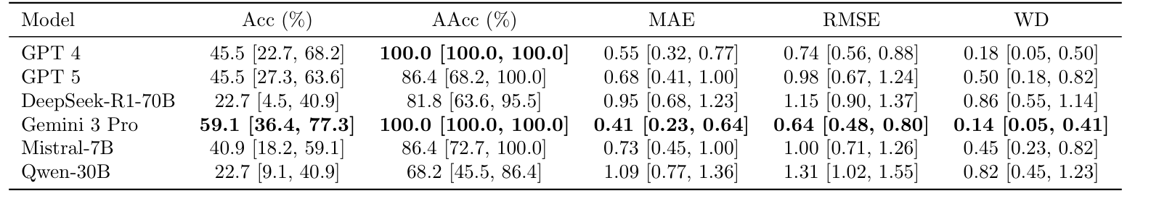
Non-shot prompting
AAcc (Acceptable Accuracy)
Definition: Prediction error ≦ 1 point counts as correct .
WD (Wasserstein Distance)
Definition: Minimum cost to transform the predicted distribution into the ground truth distribution
Significance: Ideal for ordinal data; penalizes larger errors more heavily (Lower is better).

Slide 29
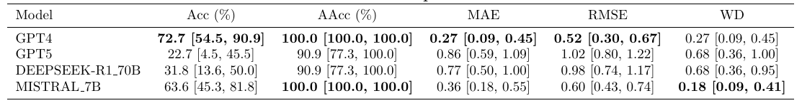
Few-shot prompting

Slide 30
Disscussion

Slide 31
Top Performing Models
GPT-4 (Few-Shot)
Highest Accuracy: Achieved 72.7%, significantly outperforming all other models.
Lowest Error: Recorded the lowest Mean Absolute Error (MAE) of 0.27, with all prediction errors falling within 1 point (AAcc 100%).
Best Fit: The rating distribution aligns highly with human experts (WD 0.27).
Gemini 3 Pro (Non-Shot)
Zero-Shot Champion: Achieved 59.1% accuracy without any examples, outperforming many few-shot models.
Excellent Distribution Alignment: Recorded the lowest Wasserstein Distance (0.14) across all experiments, demonstrating a precise capture of scoring standards.
Mistral 7B (Few-Shot)
Greatest Learning Potential: Accuracy jumped significantly from 40.9% to 63.6% after introducing examples.
High Efficiency: Despite having smaller parameters, it showed excellent error control (WD 0.18) after few-shot learning.

Slide 32
Notable Trends & Anomalies
GPT-5 (Anomalous Regression in Few-Shot)
Performance Degradation: Accuracy surprisingly dropped from 45.5% to 22.7% after providing examples.
Increased Error: MAE worsened from 0.68 to 0.86, suggesting potential confusion or overfitting to this specific prompt.
DeepSeek-R1 (Consistently High Error)
Struggle with Standards: Prediction error (RMSE) remained consistently high (0.98 - 1.15) regardless of whether examples were provided.
Large Distribution Gap: In the Non-Shot setting, WD reached 0.86, indicating a significant divergence between its scoring logic and the experts’.
Overall Observation
The Few-Shot Effect: Ainterference for GPT-5.cted as a powerful booster for GPT-4 and Mistral, but caused negative

Slide 33
Potential Causes for Few-Shot Degradation
Implementation Discrepancy (GUI vs. API)
Interface Inconsistency: Non-Shot tests utilized the Graphical User Interface (GUI), which often includes optimized system prompts; whereas Few-Shot tests switched to the API for automation.
Parameter Sensitivity: Default API settings (e.g., Temperature) may differ from the specific modes used in the GUI, altering the output distribution and scoring stability.
Negative Transfer from Examples
Alignment Issues: The model might overfit to the specific idiosyncrasies of the examples rather than applying the general MDS-UPDRS criteria.

Slide 34
Future work

Slide 35
Future work
Validation of Environment & Tool Impact
GUI Re-evaluation: Conduct Few-Shot re-tests using the Graphical User Interface (GUI) for models that showed degradation (e.g., GPT-5).
Integration of Retrieval-Augmented Generation (RAG)
Construct a database containing MDS-UPDRS guidelines, clinical case studies
Enhanced Feature Extraction:
Incorporate a lightweight neural network (e.g., CNN or LSTM) prior to the LLM to specifically process time-series data and extract precise numerical features (e.g., decay rate, coefficient of variation).

Slide 36
Thank you for listening

